Slide 1
STORYTELLING CASE STUDY: AIRBNB, NYC PRESENTATION - I
BY
RAGUL | POOJA KUMARI | NEELANJAN ROY

Slide 2
OBJECTIVE
Identify and prioritize high-value hosts based on factors like property type, location etc.,
Optimize property offerings in key areas based on neighborhoods, property types, and pricing ranges.
Provide early recommendations to leaders of Airbnb in order to help them make right business decisions.

Slide 3
BACKGROUND
For the past few months, Airbnb has seen a major decline in revenue.
Now that the restrictions have started lifting and people have started to travel more, Airbnb wants to make sure that it is fully prepared for this change.
To prepare for the next best steps that Airbnb needs to take as a business, analysis of dataset consisting of various Airbnb listings in New York has to be done.

Slide 4
DATA PREPARATION
Data cleaning: Handling missing values & dropping insignificant column.
Creation of new columns from existing numerical columns.
Creating visualizations with tableau.

Slide 5
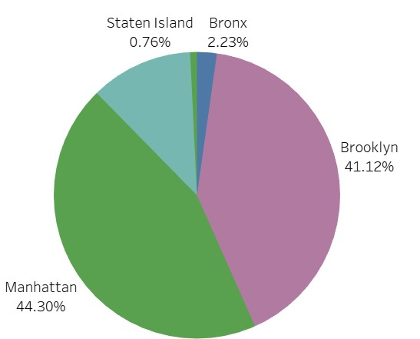
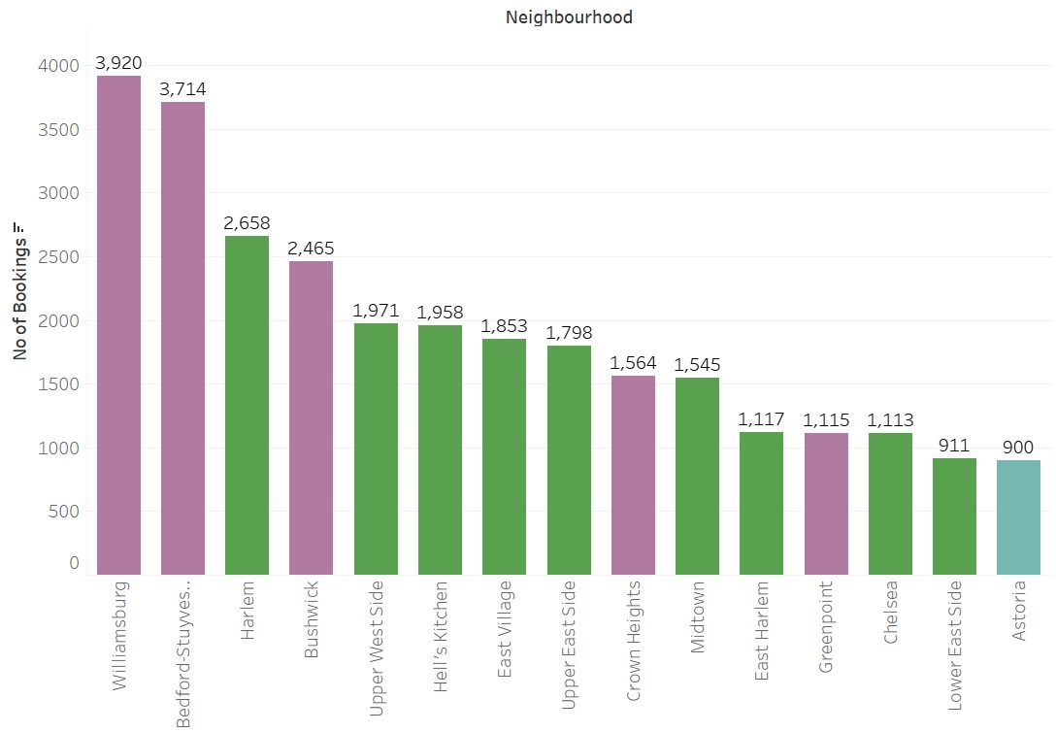
TOP NEIGHBOURHOOD GROUPS BASED ON BOOKINGS
Manhattan holds 44.30% of total bookings among the other neighbourhood groups followed by Brooklyn with 41.12% bookings.
Among the neighbourhood, Williamsburg and Bedford-Stuyvesant accounts for 7634 bookings and both the neighborhoods belong to Brooklyn neighborhood group.
Top 15 neighborhood accounts for 58.4% of total bookings.

Slide 6
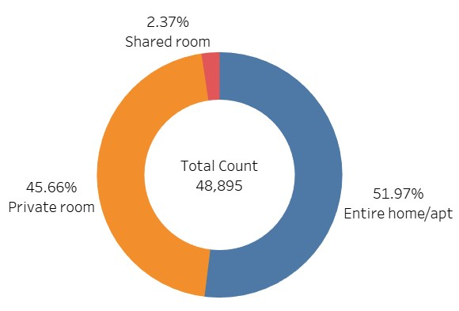
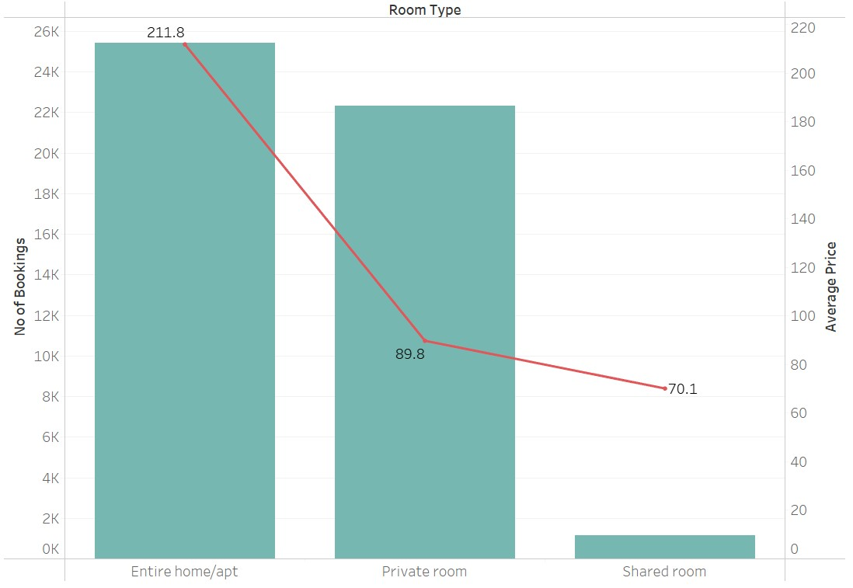
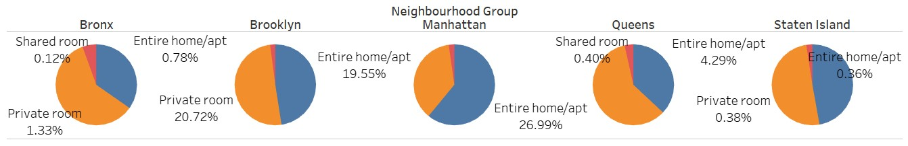
BOOKINGS BASED ON ROOM TYPES
Among the room types, “Entire home/apt” accounts 51.97% followed by Private rooms which accounts 45.66% of total share of bookings.
Among the different neighbourhood groups, except for Manhattan, all other neighbourhood group has Private room has major share of bookings.
In Manhattan, ‘Entire home/apt’ accounts for 60.93% of total bookings and private room accounts for 36.85% of bookings.

Slide 7
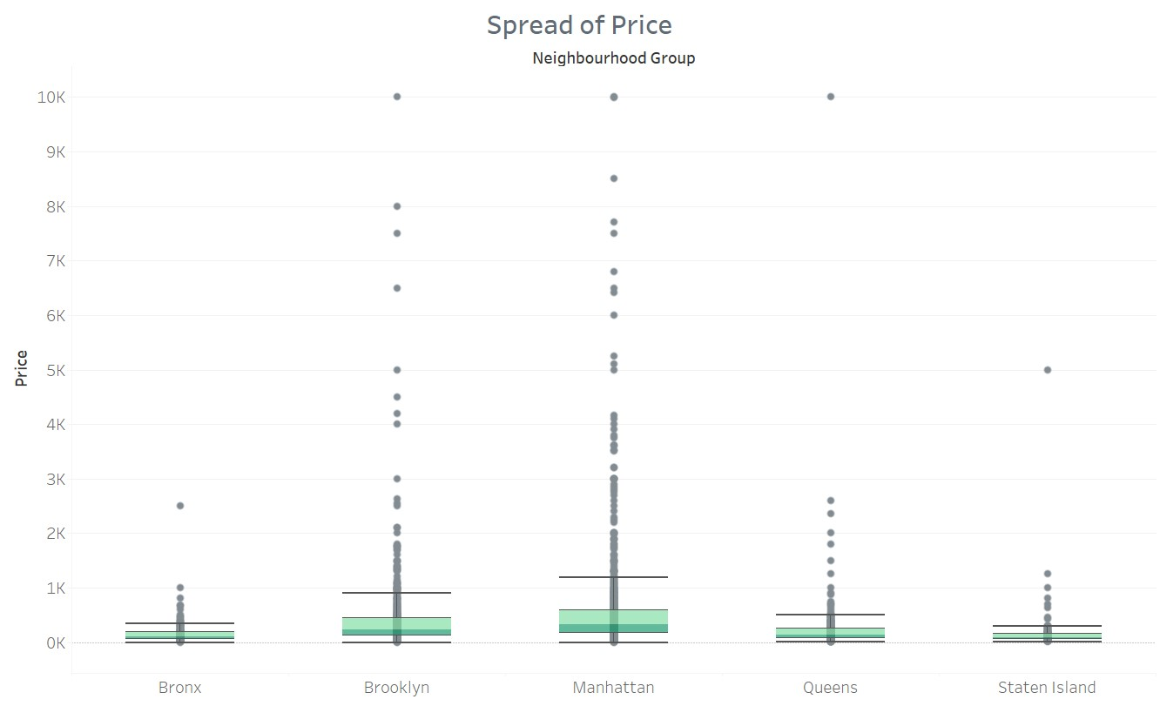
DISTRIBUTION OF PRICE AMONG NEIGHBOURHOOD GROUPS
Among the neighbourhood group, prices of property has been spread uniformly with larger range for Manhattan and Brooklyn neighbourhood groups.
Manhattan, Brooklyn and Queens have an property priced at 10,000 USD which is very high considering the medians of 329$, 225.5$ and 142$ respectively.
Upper whisker of all the neighbourhood groups are within the range of 1,500 USD and outliers could be detected in all the neighbourhood groups.

Slide 8
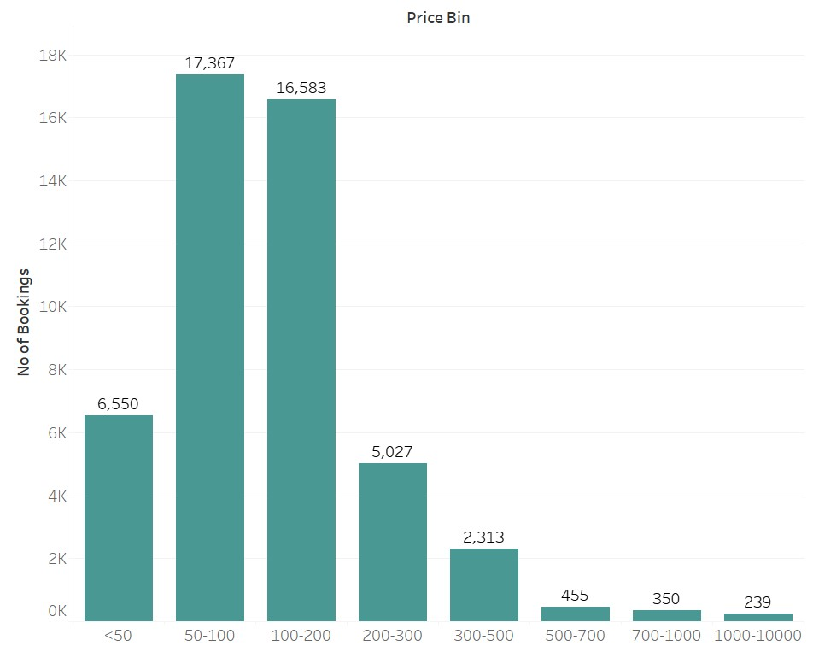
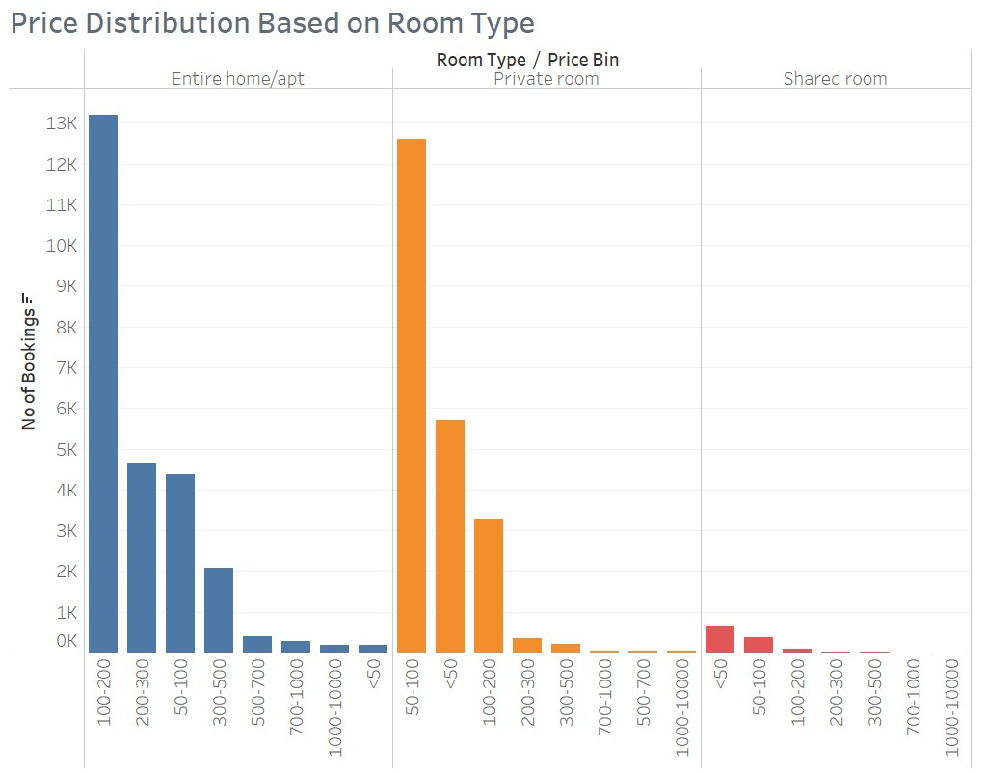
PRICE DISTRIBUTION BASED ON ROOM TYPES
A substantial 69.45% of total bookings are attributed to properties falling within the price range of $50 to $200.
Among the room types, properties within price range of 100 to 200 USD account for higher number of bookings in Entire home/apt segment where 50 to 100 USD range in private room segment.
In the shared room segment, properties less than 50 USD has higher number of bookings.

Slide 9
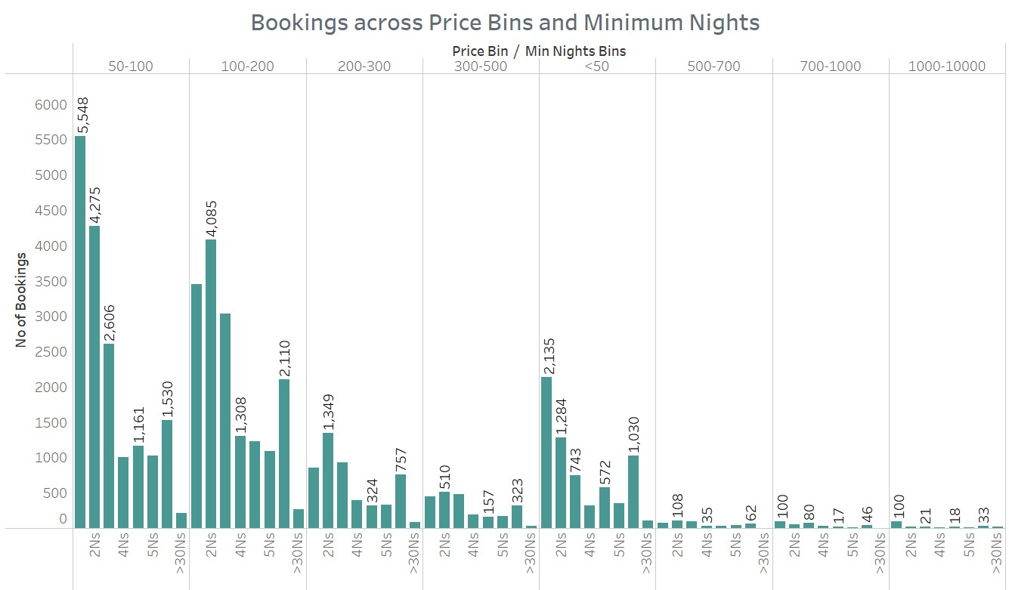
BOOKINGS BASED ON MINIMUM NIGHTS
Properties with minimum one night and two nights accounts for 49.94% of total bookings.
Further, properties within minimum one night has highest number of bookings irrespective all the price ranges.
Listings within the price range of 50 to 100 USD and having minimum one night has highest number of bookings which accounts for 5548.

Slide 10
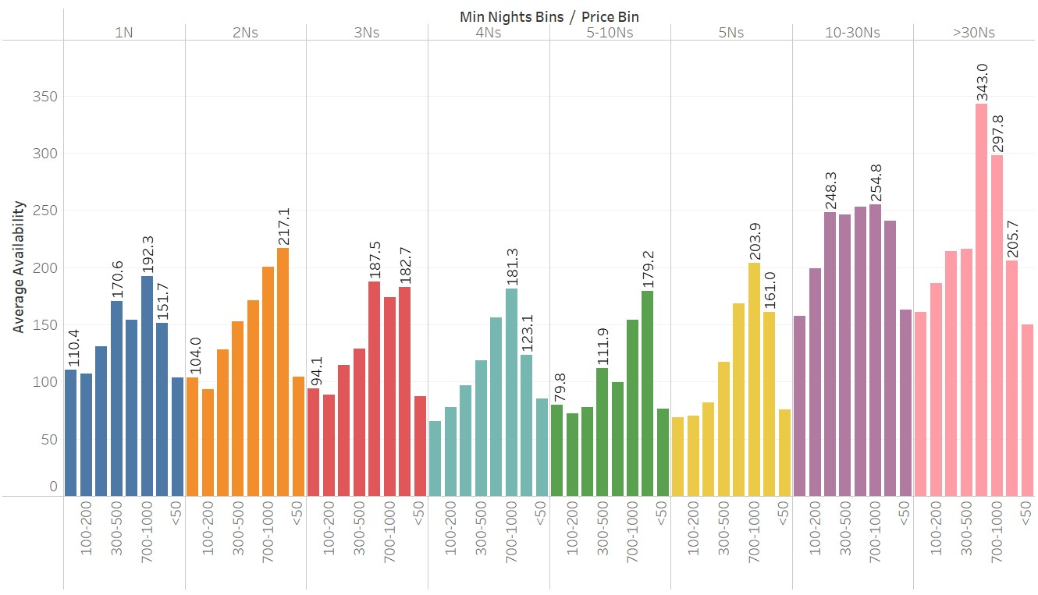
AVAILABILITY BASED ON PRICE AND MINIMUM NIGHTS
Properties within the range of 700 to 1000 USD is available around 197 days on an average around the year.
Among the minimum nights, 10 to 30 days range has highest average availability of 192 days.
Though the properties with minimum of one night has highest number of bookings, availabilities of properties within minimum one nights is relatively low which stands at 113 days.

Slide 11
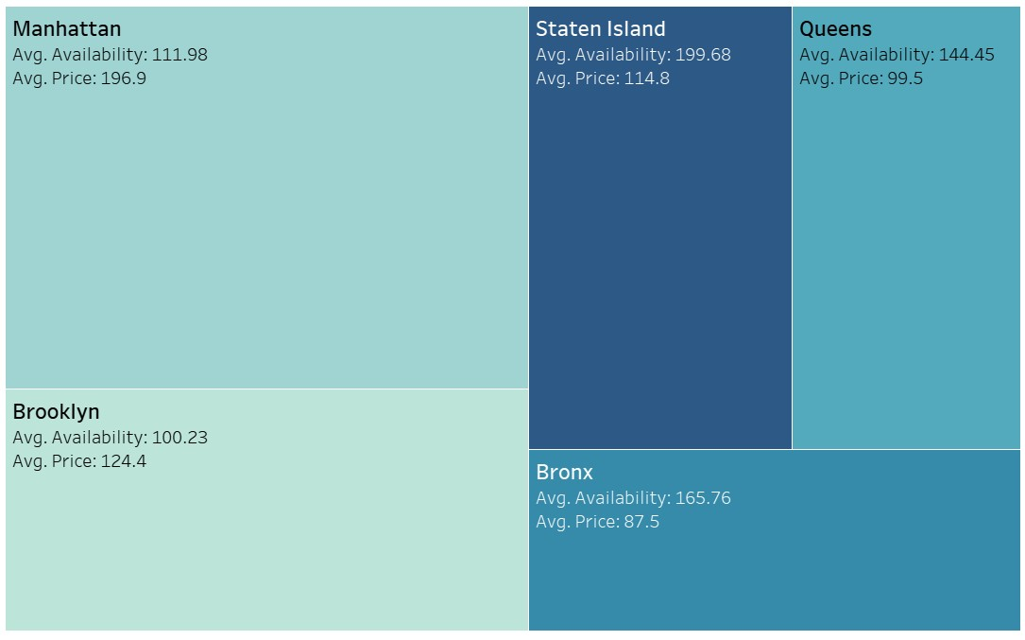
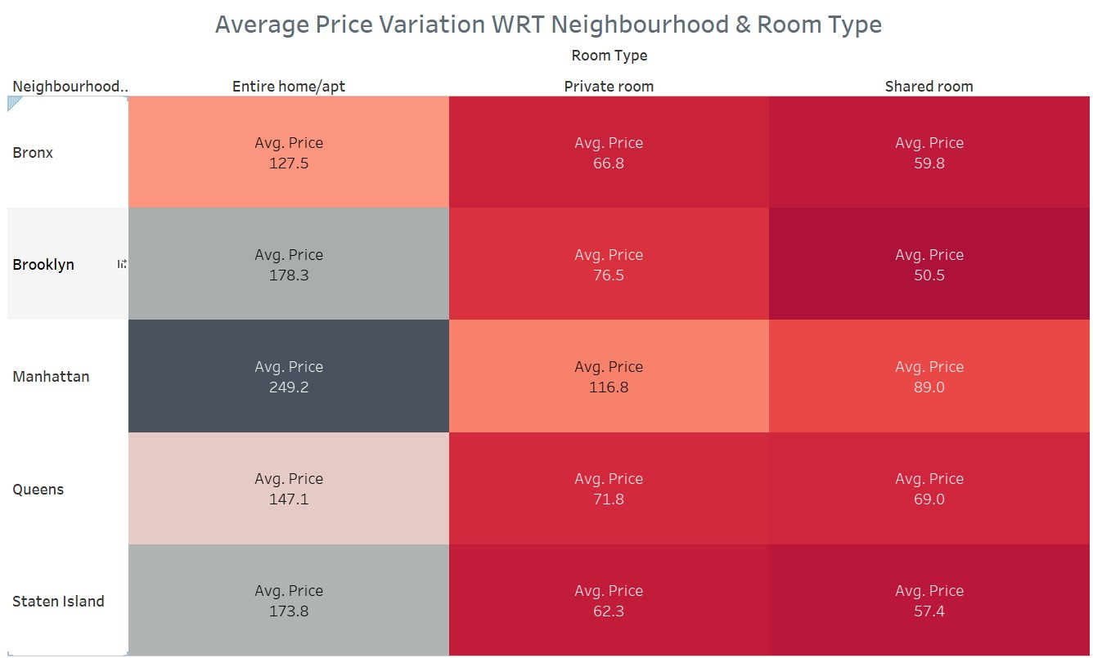
PRICE & AVAILABILITY BASED ON NEIGHBOURHOOD GROUP
Among the neighbourhood groups, Manhattan has highest average price of 111.98 USD with average availability of 197 days throughout the year.
Staten Island has average price of 114.8 USD has highest average availability of 200 days throughout the year.
Average price of properties in Manhattan with entire home/apt room types stands as high as 249.2 USD.

Slide 12
BUSINESS RECOMMENDATIONS
A significant trend has emerged among customers, with a clear preference for listings falling within the price range of $50 to $200, as evidenced by a substantial 33,950 bookings within this specific pricing bracket.
The emphasis should be directed towards the availability of properties offering minimum stay options of 1 and 2 days, particularly in the Brooklyn and Manhattan neighborhood groups.
The top 10 neighborhoods, based on bookings, exhibit a comparatively lower average availability of 107 days, which falls below the overall neighborhood average of 152 days. Consequently, there is a need to enhance the availability of properties in these top-performing neighborhoods.

